Slide 1
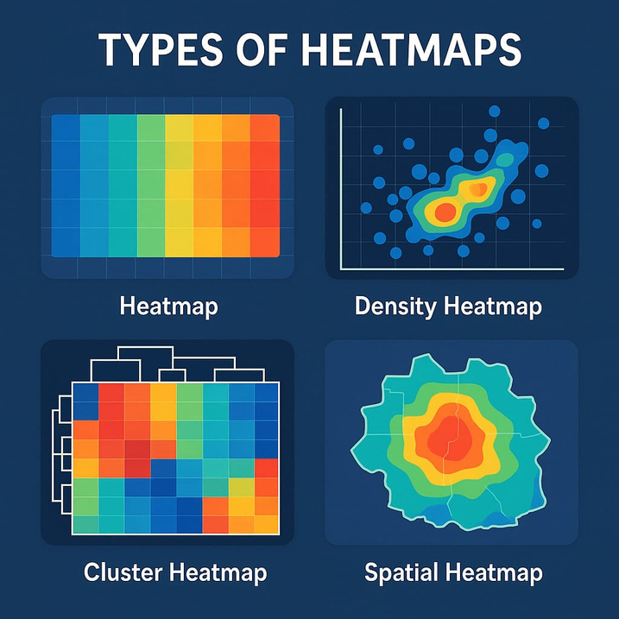



SIR M VISVESVARAYA INSTITUTE OF TECHNOLOGY
VISUALIZING DATA WITH HEATMAPS
UNCOVERING PATTERNS, ANOMALIES & CORELATIONS
HANSINI D
KARTHIK REDDY
UDAY KIRAN
VARSHITHA P

Slide 2
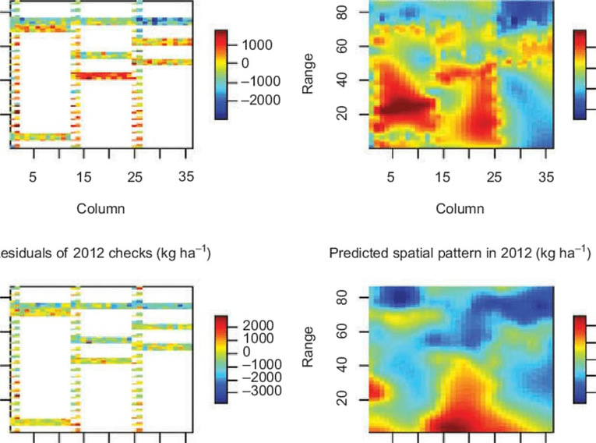
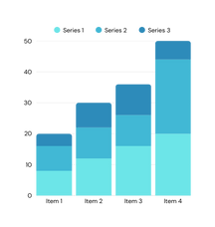
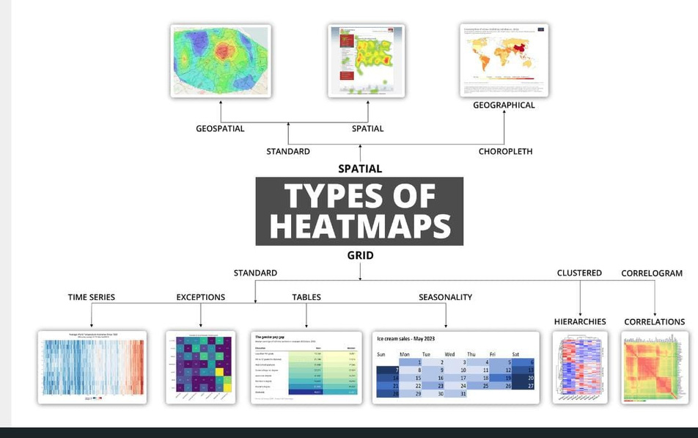
HEAT MAPS
TYPES OF
It is a graphical representation of data where individual values in a matrix are represented as colour
provides an immediate visual summary
HEAT MAPS
It MATTERS because in large datasets raw number are overwhelming. heatmaps make it easy to detect patterns , treands
It is USED to highlight patterns, relationships, and areas of high concentration or density in various fields, including web analytics, urban planning, and scientific research
Correlation Heatmaps
2D matrix Heatmaps
Time Based heatmaps
Geospatial Heatmaps
Confusion matrix
Clustring Heatmaps

Slide 3

TYPES OF HEATMAPS
Gives the relationship strength between variables
eg: network load correlates with cell drop rate
Correlation
Visualizes raw values or computer matrics (not necessarily correlation)
eg: cells contain actual values, count, frequency .
no fixed range(-1,1) , used for general visualization
2D Matrix
Time-Based
Tracks Data changes over the time. this visualizes the hourly call drop rate ot signal quality across the cities , it highlights variations in network reliablity throughout the day using a colour gradient, red for high drops, green for low drops.
Simulates signal streangth across different geographic locations . The colour greadient from red to light color represent high signal streangth to low.
Geospatial
Helps in measure how well your model can classify this usefull categories by comparing actual labels v/s predicted labels
Confusion
A cluster heat maps is a two - dimensional representation of data where individual values contained in a matrix are represented as colors .
This is a visualization tool that combine two primary trchniques, heatmapping and hierarchical clustring , to reveal patterne and relationships in complex datasets.
Cluster

Slide 4
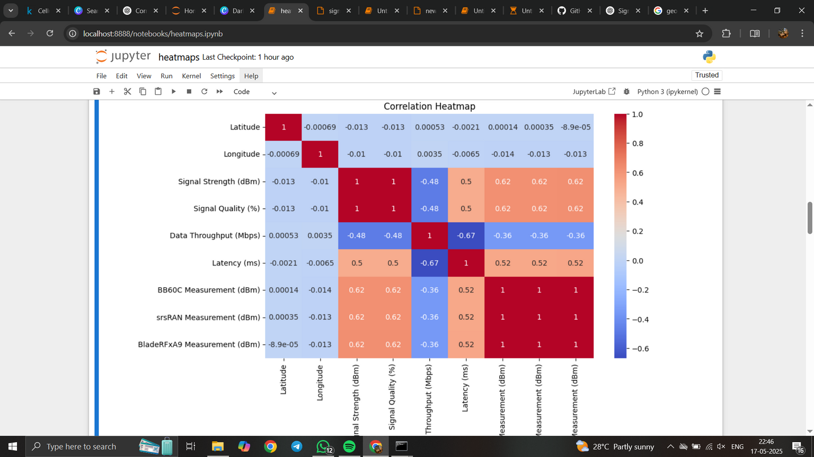
Correlation Heatmaps
code
import seaborn as sns
import matplotlib.pyplot as plt
plt.figure(figsize=(10,6))
sns.heatmap(df.corr(numeric_only=True),annot=True, cmap='coolwarm')
plt.show()
Purpose:
Visualize correlation coefficients (e.g., Pearson, Spearman) between pairs of variables in a dataset.
Features:
Shows how strongly variables are linearly related.
Values range from -1 to 1:
1 = perfect positive correlation
0 = no correlation
-1 = perfect negative correlation
Commonly used in statistical analysis and machine learning to assess multicollinearity.
Example Use Case:
Analyzing relationships between numerical features in a dataset (e.g., height, weight, age).
Output

Slide 5


Slide 6
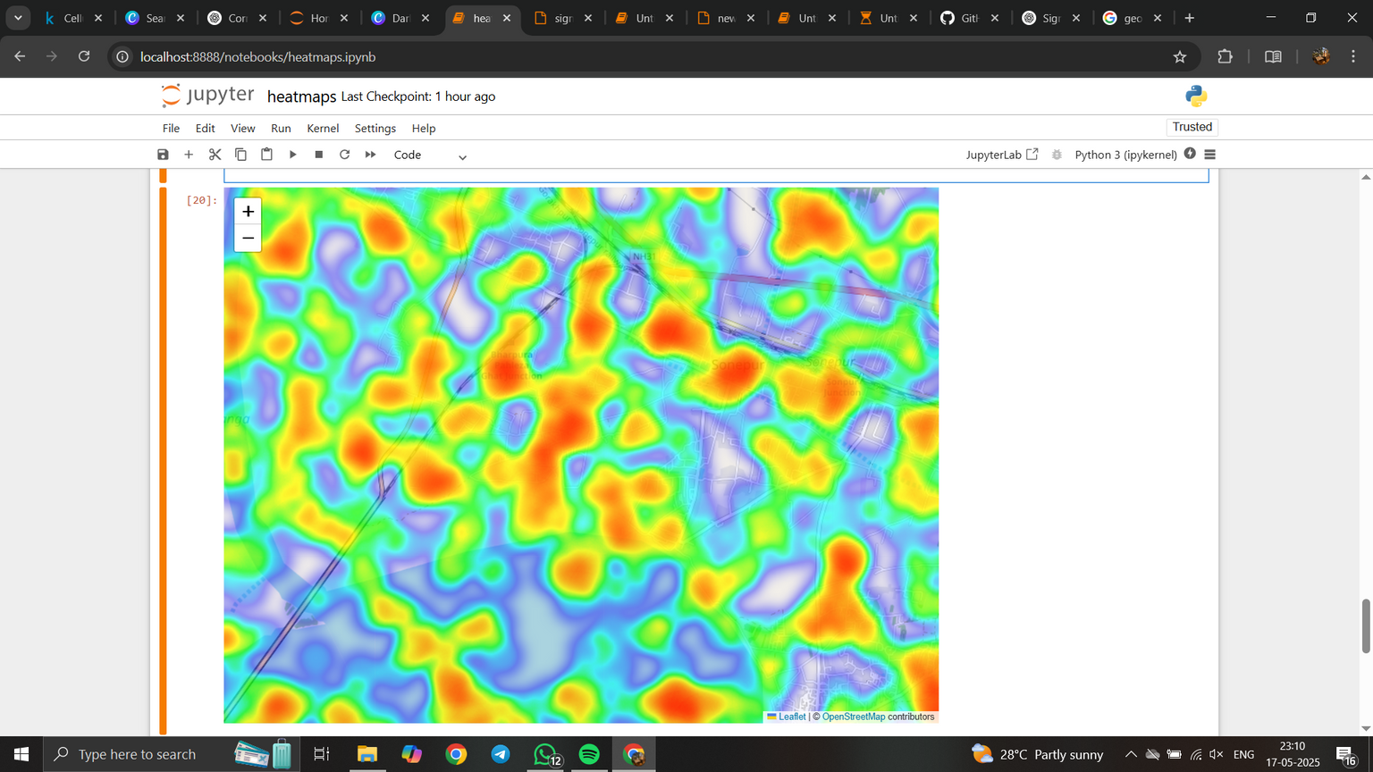

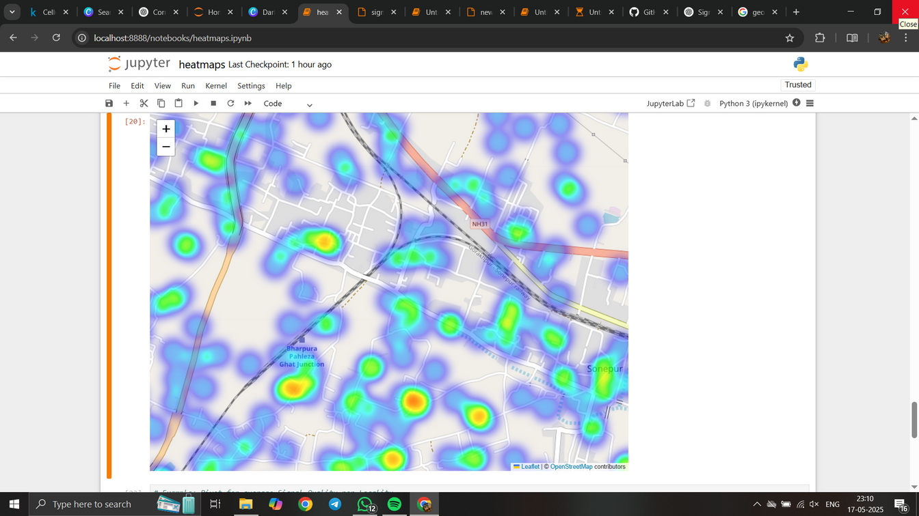
Geospatial Heatmaps
import folium
from folium.plugins import HeatMap
# Create base map
m = folium.Map(location=[df["Latitude"].mean(), df["Longitude"].mean()], zoom_start=11)
These are used to visualize and display a geographic distribution of data
what is folium.pluging.heatmaps :
used to create a geographic heatmaps on a map
visualizes density or intensity of the points using location (in our case it is signal strength
Red spots → locations with high signal quality (good)
Green/Blue spots → locations with poor signal quality (bad)
Best for:
Visualizing signal quality distribution over locations
Finding dead zones or low-performance areas
# Add heat layer
heat_data = [[row['Latitude'], row['Longitude'], row['Signal Quality (%)']] for _, row in df.iterrows()]
HeatMap(heat_data).add_to(m)
m.save("geo_heatmap.html")
from IPython.display import IFrame
IFrame("geo_heatmap.html", width=800, height=600)

Slide 7
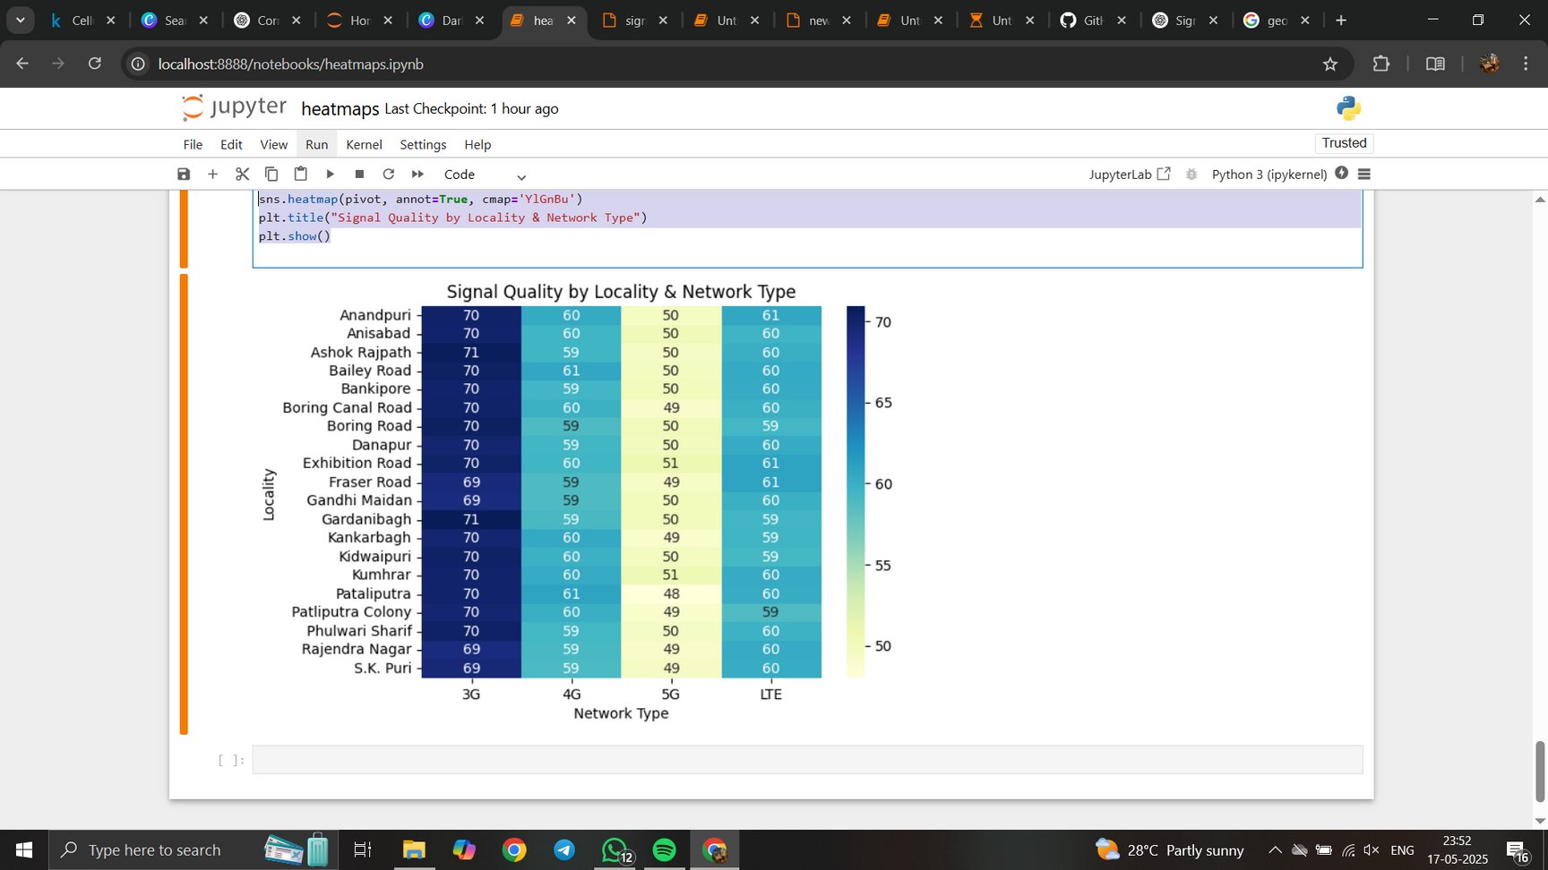

Custom Categorical Heatmap (pivot-based)
Uses a pivot table to aggregate data across two categorical dimensions (like: Locality and Network Type), then visualizes the aggregated values which are the average signal quality using a heatmap.
Why:
Aggregate complex data clearly into an easy-to-read 2D matrix, using colour intensity and numbers to show performance metrics (like average signal quality).
Can instantly compare performance across multiple regions, technologies, or time slots, etc., without sifting through raw data.
Healps in making decisions like where to upgrade towers or troubleshoot issues
# Pivot for average Signal Quality per Locality
pivot = df.pivot_table(values='Signal Quality (%)', index='Locality', columns='Network Type', aggfunc='mean')
#index = y axis, columns = x axis, aggerate function type can be sum , mean count etc acc to numpy func
sns.heatmap(pivot,annot=True,cmap='YlGnBu')
plt.title("Signal Quality by Locality & Network Type")
plt.show()

Slide 8
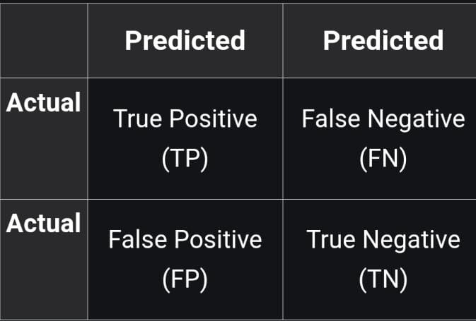
Confusion Matrix
Visualizes the performance of classification madel by showing actual v/s predicted labels
A 2*2 confusion matrix has:
True Positive (TP): It is the total counts having both predicted and actual values are Dog.
True Negative (TN): It is the total counts having both predicted and actual values are Not Dog.
False Positive (FP): It is the total counts having prediction is Dog while actually Not Dog.
False Negative (FN): It is the total counts having prediction is Not Dog while actually, it is Dog.
we can calculate:
Accuracy : overall, how often is the classifier correct
= TN+TP/TN+FP+FN+TP
Misclassification rate : overal how often it is wrong
= FN+FP/TN+FP+FN+TP
True positive rate : When it’s actually yes, how often does it predict yes (AKA :”sensitivity” or “Recall”
= TP/Actuall Yes
Requirements:
You need true labels (e.g., actual class of signal: "Good", "Poor")
And predicted labels (e.g., from a model)
we must test and train the models and must do prediction analysis by using that we plot the graph of confusion matrix

Slide 9
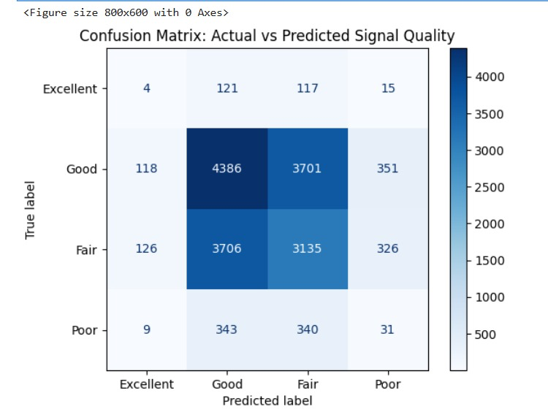
ggd
df['Predicted Category'] = df['Signal Category'].sample(frac=1).reset_index(drop=True)
cm = confusion_matrix(df['Signal Category'], df['Predicted Category'], labels=["Excellent", "Good", "Fair", "Poor"])
disp = ConfusionMatrixDisplay(confusion_matrix=cm, display_labels=["Excellent", "Good", "Fair", "Poor"])
plt.figure(figsize=(8, 6))
disp.plot(cmap='Blues', values_format='d')
plt.title("Confusion Matrix: Actual vs Predicted Signal Quality")
plt.grid(False)
plt.show()

Slide 10
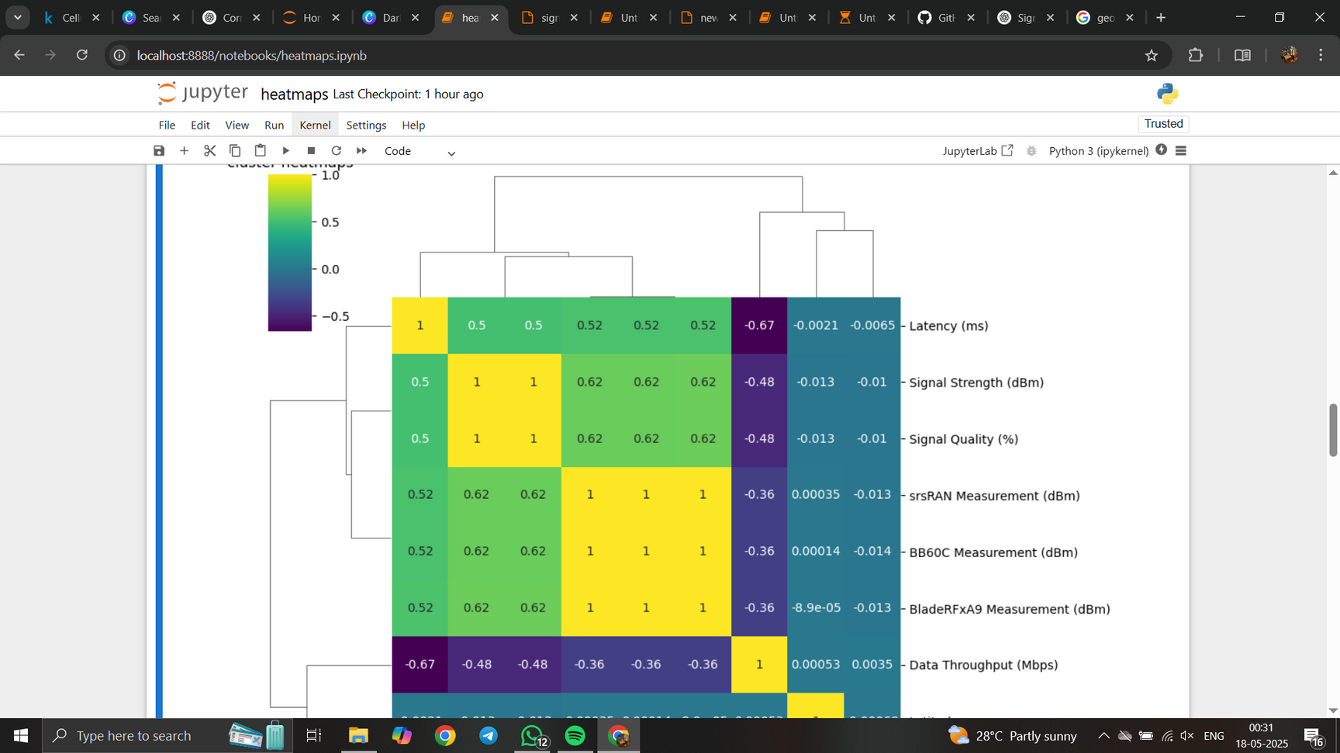

Cluster heatmaps
Groups similar rows and columns based on the similarity of their values, using hierarchical clustering.
Instead of just showing raw values like a normal heatmap, it reorders and groups the rows and columns to highlight patterns or clusters.
Why To Use:
Automatic Grouping
Pattern Recognition:
Which localities behave similarly
Which network types offer similar performance
What Can Be Done After :
Tune or optimize specific regions or network settings
Segment areas into performance tiers
sns.clustermap(df.corr(numeric_only=True), annot=True, cmap='viridis')
plt.title("cluster heatmaps")
plt.show()

Slide 11
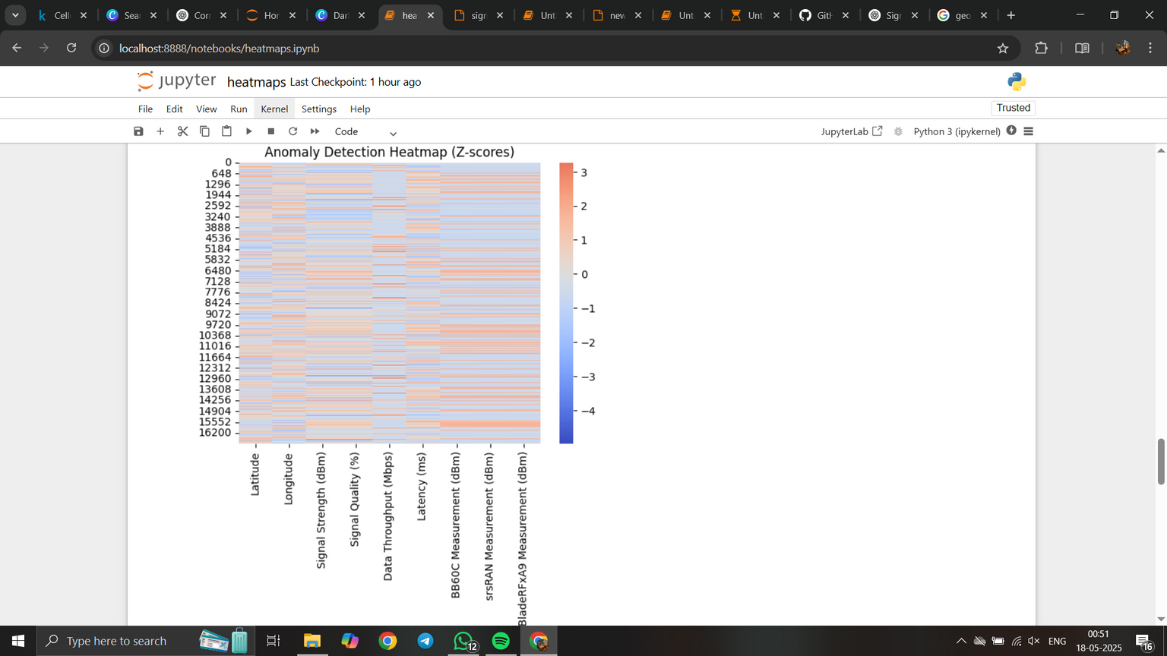
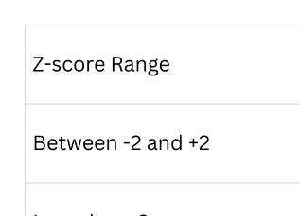
Anomaly Detection Heatmap
Anomaly detection is the process of identifying data points that deviate significantly from the normal pattern or behavior.
An anomaly could mean unexpectedly low signal strength, unusually high latency, or weird fluctuations in throughput.
The Z-score (also called standard score) measures how far a data point is from the mean, in terms of standard deviations. Z=σ*X/μ
​Where:
X = individual value
μ = mean of the column
σ = standard deviation of the column
Best for:
Spotting outliers in signal measurements
Diagnosing abnormal behaviors in real-time metrics
z=x-𝜇/𝜎

Slide 12
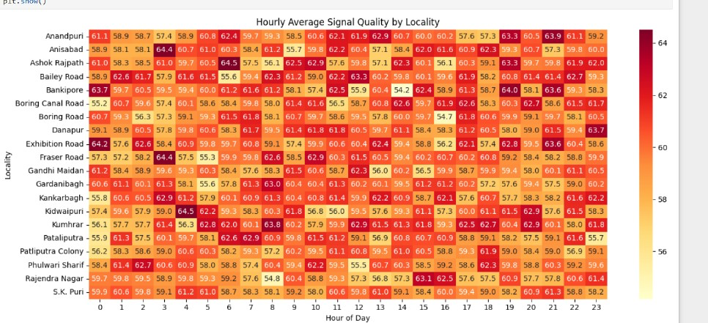
Timeseries Heat map
ggd
Visualize how mobile signal quality varies hourly across different localities:
This heatmap shows the average signal quality (%) for each hour (0 to 23) across various localities.
• Darker red shades indicate higher signal quality, while lighter yellow shades indicate lower signal quality.
• X-axis: Hour of the day
• Y-axis: Localities
• Values inside cells: Mean signal quality for that hour and locality.
df['Hour'] = df['Timestamp'].dt.hour
# Create pivot: Hour vs. Locality (you can replace 'Locality' with other columns like 'Device ID' or 'Network Type')
pivot = df.pivot_table(values='Signal Quality (%)', index='Locality', columns='Hour', aggfunc='mean')
# Plot heatmap
plt.figure(figsize=(14, 6))
sns.heatmap(pivot, annot=True, fmt=".1f", cmap='YlOrRd')
plt.title("Hourly Average Signal Quality by Locality")
plt.xlabel("Hour of Day")
plt.ylabel("Locality")
plt.tight_layout()
plt.show()

Slide 13
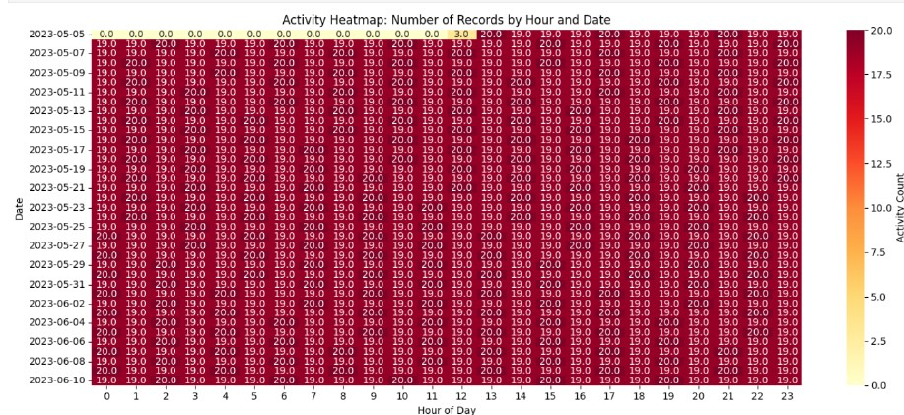
Activity Heatmap
ggd
Purpose:
visualizes how active or significant a certain event (like signal reporting, call drops, data usage, etc.) is across time (hours) and dates or locations
Shows how a metric (e.g., signal quality) changes over time.
Data Needed: Timestamp + some numeric value, like Signal Quality (%).
Visualization: Average signal quality per hour/day.
Good for: Diagnosing performance issues across different times.
Requirements for an Activity Heatmap
To create one, you need:
A timestamp (date + time).
A way to group activity (e.g., by hour, date, locality, etc.).
This heatmap shows the average signal quality (%) for each hour (0 to 23) across various localities.
• Darker red shades indicate higher signal quality, while lighter yellow shades indicate lower signal quality.
• X-axis: Hour of the day
• Y-axis: Localities
• Values inside cells: Mean signal quality for that hour and locality.

Slide 14
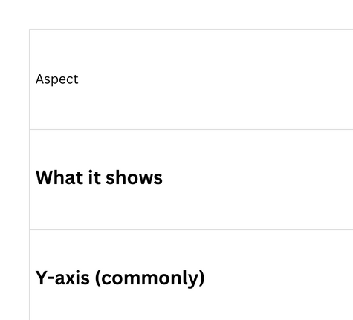

Slide 15



THANKS FOR JOINING US TODAY

